Slide 1

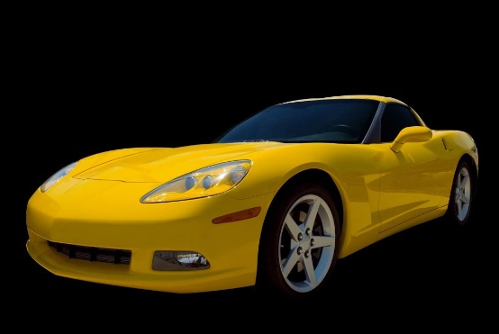
Penn Liberty Motors
Philadelphia, PA
www.libertymotors.biz

Slide 2
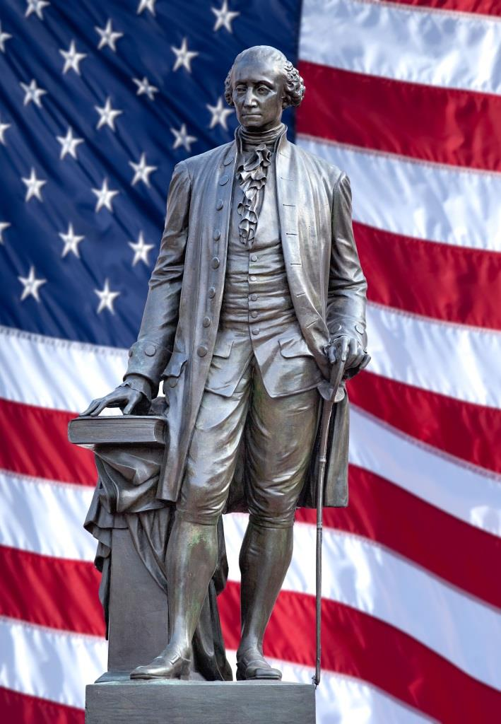
Our Location
Located in Center City Philadelphia
The city of our Founding Fathers
Convenient to:
  Public transportation
  Historic attractions
Plenty of free parking

Slide 3
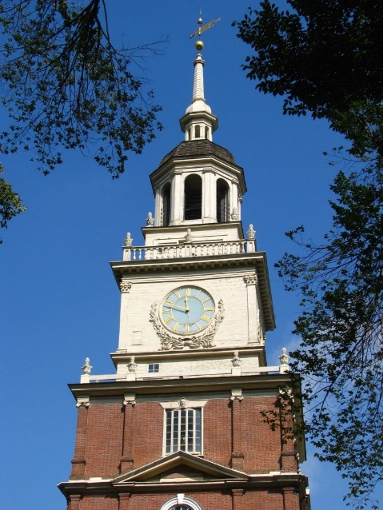
Independence National Park
  Visit Cradle of Liberty
  Tour Independence Hall
  Visit Independence Living History Center

Slide 4
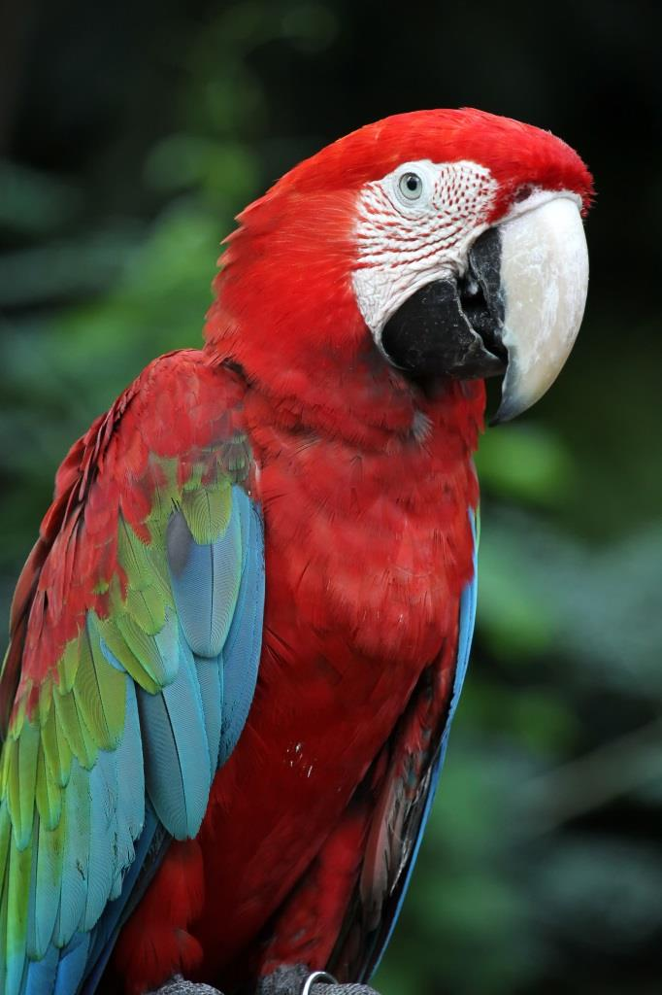
Philadelphia Zoo
  America’s oldest zoo
  Rides and attractions
  Exotic animals
  Conservation programs
Philadelphia Zoo

Slide 5
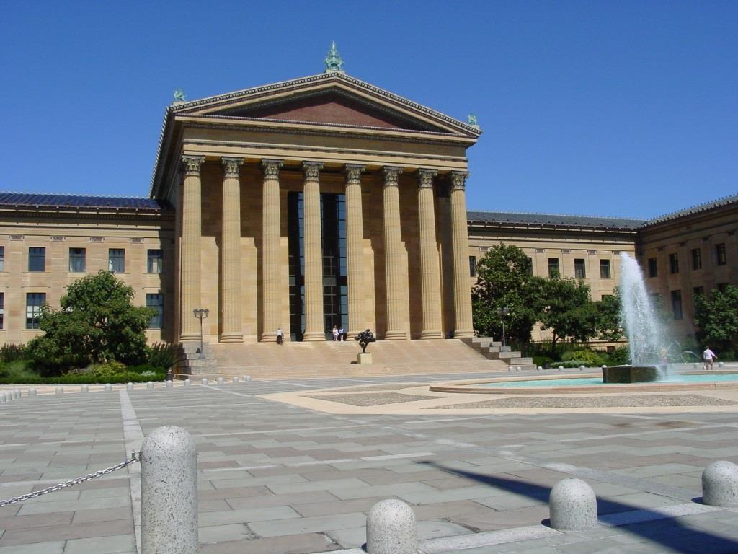
Philadelphia Museum of Art
  Museum library
  American crafts
  European art
  Architecture
Philadelphia Museum of Art

Slide 6

Rodin Museum
  Works of Auguste Rodin
  Original sketchbook
  Spectacular gardens

Slide 7
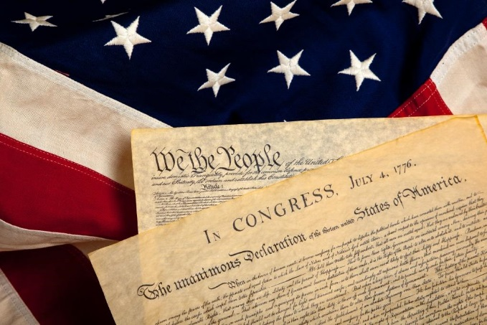
Discount Tickets
Penn Liberty Motors offers discount tickets
to these locations:
  National Constitution Center
  Independence National Park
  United States Mint
  Philadelphia Zoo
Contact Us

Slide 8
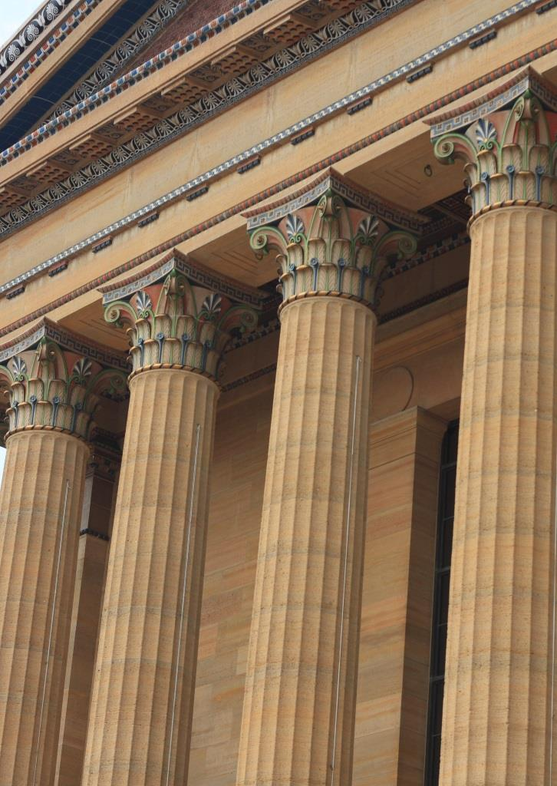
Convenient Location
Located in the cultural area of the city
Convenient to
  Public transportation
  Museums
  Exhibitions
Plenty of free parking

Slide 9

Treat Yourself to a New Sports Car
Penn Liberty Motors New Car Selections

Slide 10

Treat Yourself to a Sedan
Penn Liberty Motors New Car Selections

